Slide 1
Observability
Observability
Logs
Traces
Metrics
Figure 8.1 – The three components of observability

Slide 2
Network Observability
Flow logs,
routing tables
Network Observability
Telemetry Data
Action
Data platform
Ingest telemetry data
Auto remediation
Figure 8.2 – The three components of network observability

Slide 3
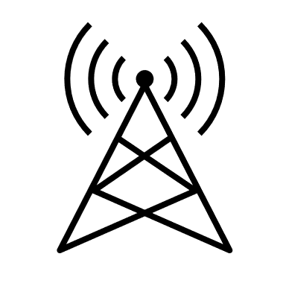



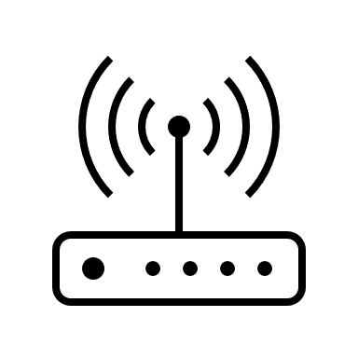
Stadium Scenario
Broadband
Massive IoT
Voice
Other
5G Core Slice
5G RU
5G RU
5G RAN
+ UPF
Figure 8.3 – CSP offering network services at a stadium event

Slide 4
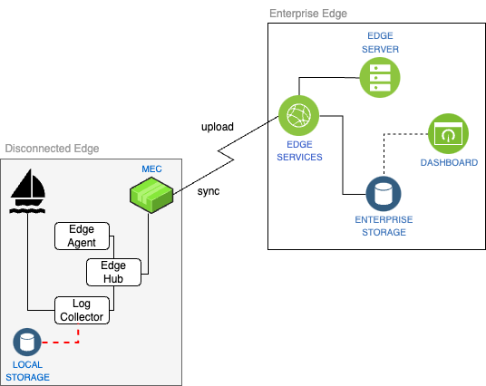
Edge Disconnected
Figure 8.4 – Edge monitoring in disconnected mode

